Slide 1
try block
Java try block is used to enclose the code that might throw an exception. It must be used within the method.
Java try block must be followed by either catch or finally block.

Slide 2
Syntax of java try-catch
try{
//code that may throw exception
}catch(Exception_class_Name ref){}
Syntax of try-finally block
try{
//code that may throw exception
}finally{}

Slide 3
catch block
Java catch block is used to handle the Exception.
It must be used after the try block only.
You can use multiple catch block with a single try.

Slide 4
Problem without exception handling
public class Testtrycatch1{
public static void main(String args[])
{
int data=50/0;//may throw exception
System.out.println(“Hi");
System.out.println(“Hello");
}
}

Slide 5
Output:
Exception in thread main java.lang.ArithmeticException:/ by zero

Slide 6
Try-catch
public class Testtrycatch2{
public static void main(String args[]){
try{
int data=50/0;
}catch(ArithmeticException e)
{
System.out.println(e);
}
System.out.println(“Hi");
System.out.println(“Hello");
}
}

Slide 7
Output:
Exception in thread main java.lang.ArithmeticException:/ by zero
Hi
Hello

Slide 8
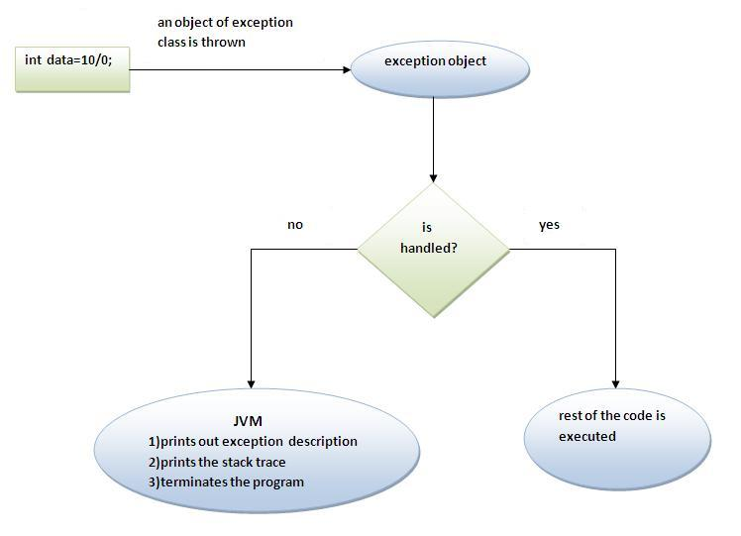
Internal working of java try-catch block

Slide 9
The JVM firstly checks whether the exception is handled or not. If exception is not handled, JVM provides a default exception handler that performs the following tasks:
Prints out exception description.
Prints the stack trace (Hierarchy of methods where the exception occurred).
Causes the program to terminate.
But if exception is handled by the application programmer, normal flow of the application is maintained i.e. rest of the code is executed.

Slide 10
Java Multi catch block
If you have to perform different tasks at the occurrence of different Exceptions, use java multi catch block
public class TestMultipleCatchBlock{
public static void main(String args[]){
try{
int a[]=new int[5];
a[5]=30/0;
}
catch(ArithmeticException e){System.out.println("task1 is completed");}
catch(ArrayIndexOutOfBoundsException e){System.out.println("task 2 completed");}
catch(Exception e){System.out.println("common task completed");}
System.out.println("rest of the code...");
}
}

Slide 11
Output
task1 is completed
Rest of the code

Slide 12
Java Multi catch block
If you have to perform different tasks at the occurrence of different Exceptions, use java multi catch block
public class TestMultipleCatchBlock{
public static void main(String args[]){
try{
int a[]=new int[5];
a[5]=30/1;
}
catch(ArithmeticException e){System.out.println("task1 is completed");}
catch(ArrayIndexOutOfBoundsException e){System.out.println("task 2 completed");}
catch(Exception e){System.out.println("common task completed");}
System.out.println("rest of the code...");
}
}

Slide 13
Output
task2 is completed
Rest of the code

Slide 14
At a time only one Exception is occurred and at a time only one catch block is executed
All catch blocks must be ordered from most specific to most general i.e. catch for ArithmeticException must come before catch for Exception .

Slide 15
class TestMultipleCatchBlock1{
public static void main(String args[]){
try{
int a[]=new int[5];
a[5]=30/0;
}
catch(Exception e){System.out.println("common task completed");}
catch(ArithmeticException e){System.out.println("task1 is completed");}
catch(ArrayIndexOutOfBoundsException e){System.out.println("task 2 completed");}
System.out.println("rest of the code...");
}
}

Slide 16
Output
Compilation error

Slide 17
class TestMultipleCatchBlock1{
public static void main(String args[]){
try{
int a[]=new int[5];
a[5]=30/0;
}
catch(Exception e){System.out.println("common task completed");}
System.out.println("rest of the code...");
}
}

Slide 18
Output
common completed
Rest of the code

Slide 19
Java Nested try block
The try block within a try block is known as nested try block in java.
Sometimes a situation may arise where a part of a block may cause one error and the entire block itself may cause another error. In such cases, exception handlers have to be nested.

Slide 20
class Excep6{
public static void main(String args[]){
try{
try{
System.out.println("going to divide");
int b =39/0;
}catch(ArithmeticException e){System.out.println(e);}
try{
int a[]=new int[5];
a[5]=4;
}catch(ArrayIndexOutOfBoundsException e){System.out.println(e);}
System.out.println("other statement);
}catch(Exception e){System.out.println("handeled");}
System.out.println("normal flow..");
}
}

Slide 21
Java finally block
Java finally block is a block that is used to execute important code such as closing connection, closing a file etc.
Java finally block is always executed whether exception is handled or not.
Java finally block follows try or catch block.

Slide 22
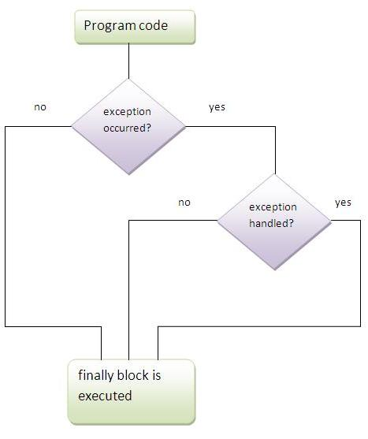

Slide 23
Case 1: finally example where exception doesn't occur
class TestFinallyBlock{
public static void main(String args[]){
try{
int data=25/5;
System.out.println(data);
}
catch(NullPointerException e){System.out.println(e);}
finally{System.out.println("finally block is always executed");}
System.out.println("rest of the code...");
}
}

Slide 24
Output:
finally block is always executed
rest of the code...

Slide 25
Case 2: finally example where exception occurs and not handled.
class TestFinallyBlock1{
public static void main(String args[]){
try{
int data=25/0;
System.out.println(data);
}
catch(NullPointerException e){System.out.println(e);}
finally{System.out.println("finally block is always executed");}
System.out.println("rest of the code...");
}
}

Slide 26
Output:
finally block is always executed
Exception in thread main java.lang.ArithmeticException:/ by zero

Slide 27
Case 3:finally example where exception occurs and handled.
public class TestFinallyBlock2{
public static void main(String args[]){
try{
int data=25/0;
System.out.println(data);
}
catch(ArithmeticException e){System.out.println(e);}
finally{System.out.println("finally block is always executed");}
System.out.println("rest of the code...");
}
}

Slide 28
Output:
Exception in thread main java.lang.ArithmeticException:/ by zero
finally block is always executed
rest of the code...
For each try block there can be zero or more catch blocks, but only one finally block.
The finally block will not be executed if program exits(either by calling System.exit()
or by causing a fatal error that causes the process to abort).

Slide 29
MCQ
class exception_handling {
public static void main(String args[]) {
try {
System.out.print("Hello" + " " + 1 / 0);
}
catch(ArithmeticException e) {
System.out.print("World");
}
}
}
a) Hello
b) World
c) HelloWorld
d) Hello World

Slide 30
Ans: World

Slide 31
class exception_handling {
public static void main(String args[]) {
try {
int a, b;
b = 0;
a = 5 / b;
System.out.print("A");
}
catch(ArithmeticException e) {
System.out.print("B");
}
finally {
System.out.print("C");
}
}
}
a) AC b) B c) ABC d) BC

Slide 32
Ans: BC

Slide 33
class exception_handling {
public static void main(String args[]) {
try {
int i, sum;
sum = 10;
for (i = -1; i < 3 ;++i)
sum = (sum / i);
}
catch(ArithmeticException e) {
System.out.print("0");
}
System.out.print(sum);
}
}
a) 0 b) 05 c) Compilation Error d) Runtime Error

Slide 34
Ans: Compilation error

Slide 35
class exception_handling {
public static void main(String args[]) {
try {
int i, sum;
sum = 10;
for (i = -1; i < 3 ;++i) {
sum = (sum / i);
System.out.print(i);
}
}
catch(ArithmeticException e) {
System.out.print("0");
}
}
}
a) -1 b) 0 c) -10 d) -101

Slide 36
Ans: -10

Slide 37
Which of these handles the exception when no catch is used?
A. Default handler
B. finally
C. throw handler
D. Java run time system

Slide 38
Ans: a

Slide 39
Java throw keyword
The Java throw keyword is used to explicitly throw an exception.
We can throw either checked or uncheked exception in java by throw keyword.

Slide 40
public class TestThrow1{
static void validate(int age){
if(age<18)
throw new ArithmeticException("not valid");
else
System.out.println("welcome to vote");
}
public static void main(String args[]){
validate(13);
System.out.println("rest of the code...");
}
}

Slide 41
Exception in thread main java.lang.ArithmeticException:not valid

Slide 42
Java Exception propagation
An exception is first thrown from the top of the stack and if it is not caught, it drops down the call stack to the previous method, If not caught there, the exception again drops down to the previous method, and so on until they are caught or until they reach the very bottom of the call stack. This is called exception propagation.

Slide 43
class TestExceptionPropagation1{
void m(){
int data=50/0;
}
void n(){
m();
}
void p(){
try{
n();
}catch(Exception e){System.out.println("exception handled");}
}
public static void main(String args[]){
TestExceptionPropagation1 obj=new TestExceptionPropagation1();
obj.p();
System.out.println("normal flow...");
}
}

Slide 44
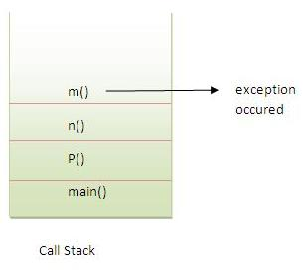
Output:
exception handled
normal flow...

Slide 45
Checked Exception
class TestExceptionPropagation2{
void m(){
throw new java.io.IOException("device error");//checked exception
}
void n(){
m();
}
void p(){
try{
n();
}catch(Exception e){System.out.println("exception handeled");}
}
public static void main(String args[]){
TestExceptionPropagation2 obj=new TestExceptionPropagation2();
obj.p();
System.out.println("normal flow");
}
}

Slide 46
Output
Compilation error

